Slide 1
Metadata Enhancement in CINERGI
Ilya Zaslavsky
San Diego Supercomputer Center, UCSD

Slide 2


EarthCube
“EarthCube is a community effort to promote interdisciplinary geoscience by enabling technology, organization, and culture that facilitates connectivity through standards and protocols to existing and emerging resources.”
NSF & GEOSCIENCE COMMUNITY PARTNERSHIP
Geoscience community involvement in decision-making processes

Slide 3

EarthCube Strategy
Build on existing
resources, a SoS
approach
Develop CI that is
responsive to
community input & assessment
Architecture
Funded Projects
Represent community
and inform NSF
Connect technical
development and
social/cultural
adoption
Governance
Community

Slide 4
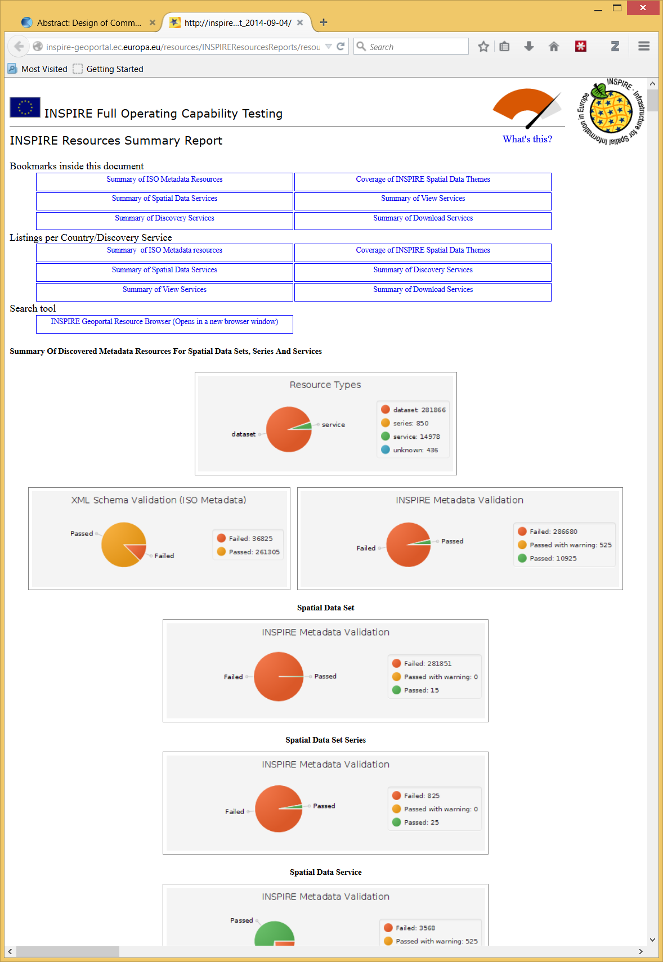
FROM: http://inspire-geoportal.ec.europa.eu/resources/INSPIREResourcesReports/resourcesReport_2014-09-04/

Slide 5
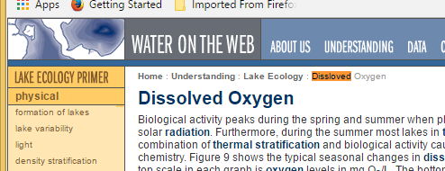
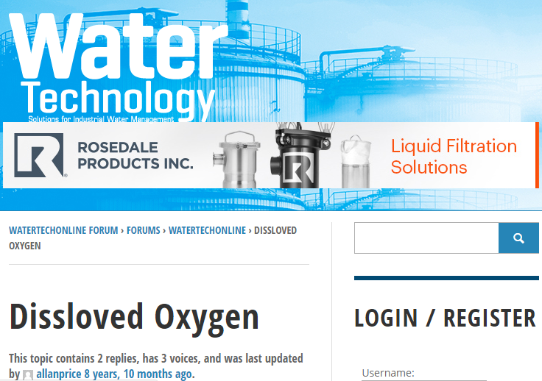
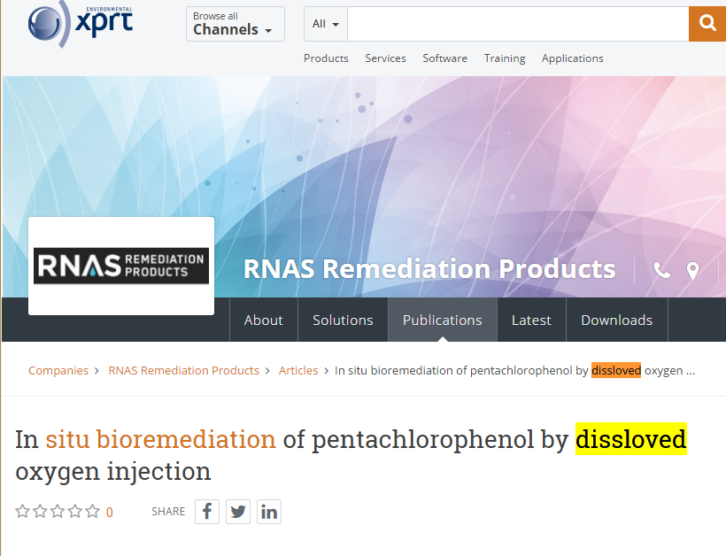
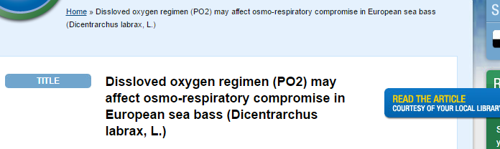
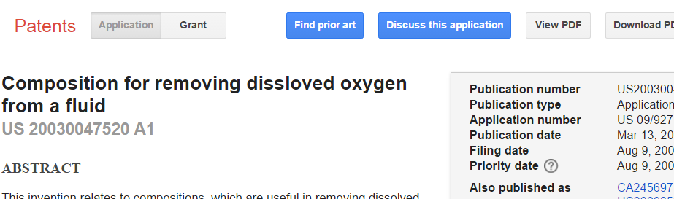
A few notes on dissloved oxygen…

Slide 6
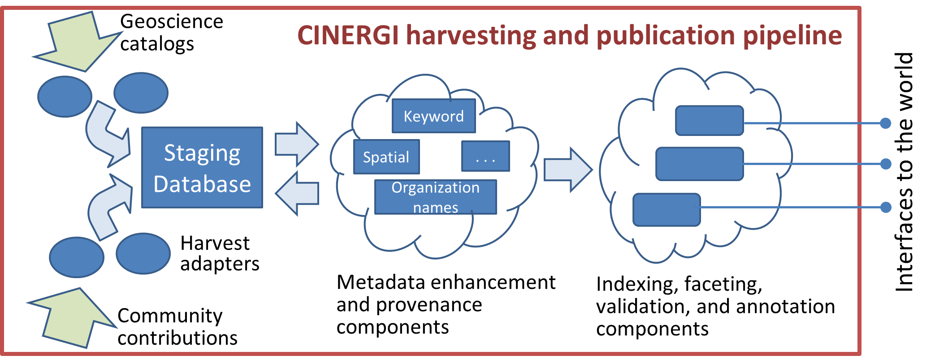
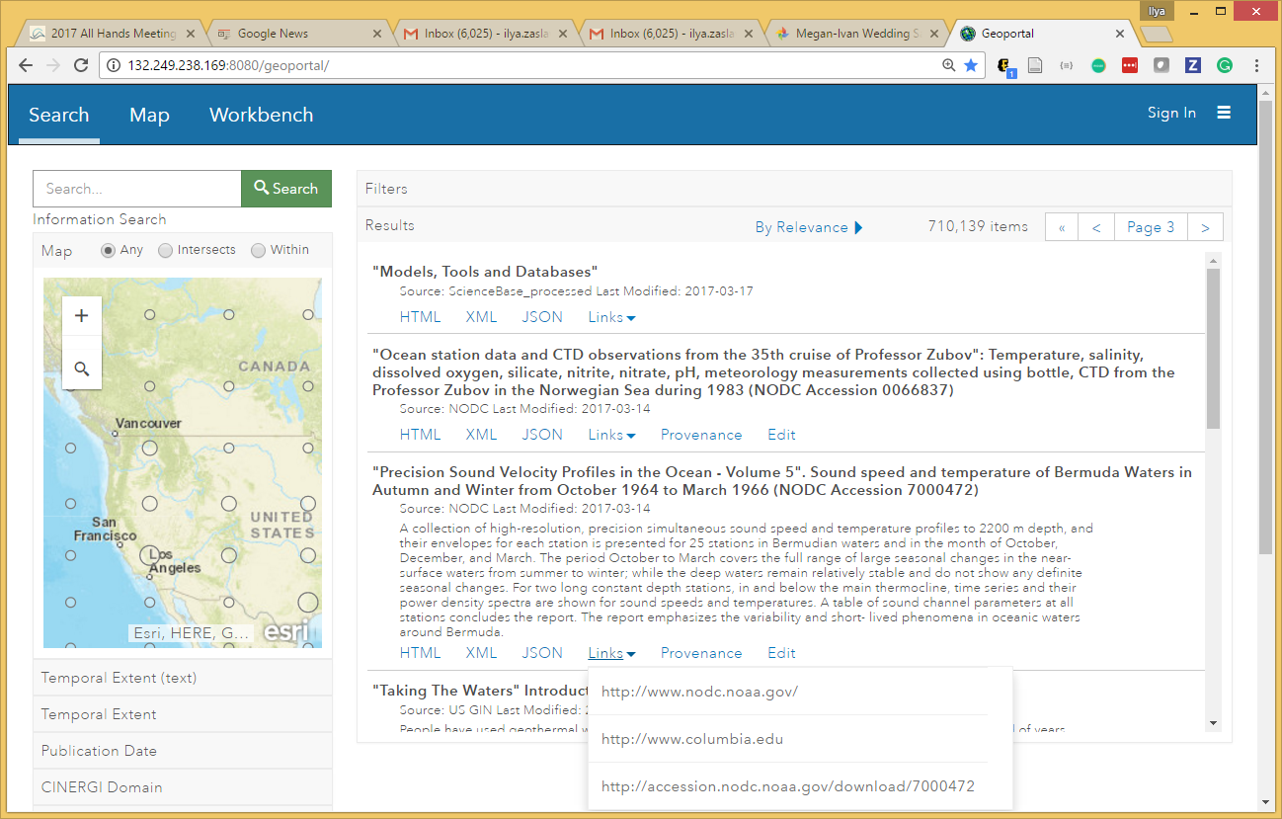
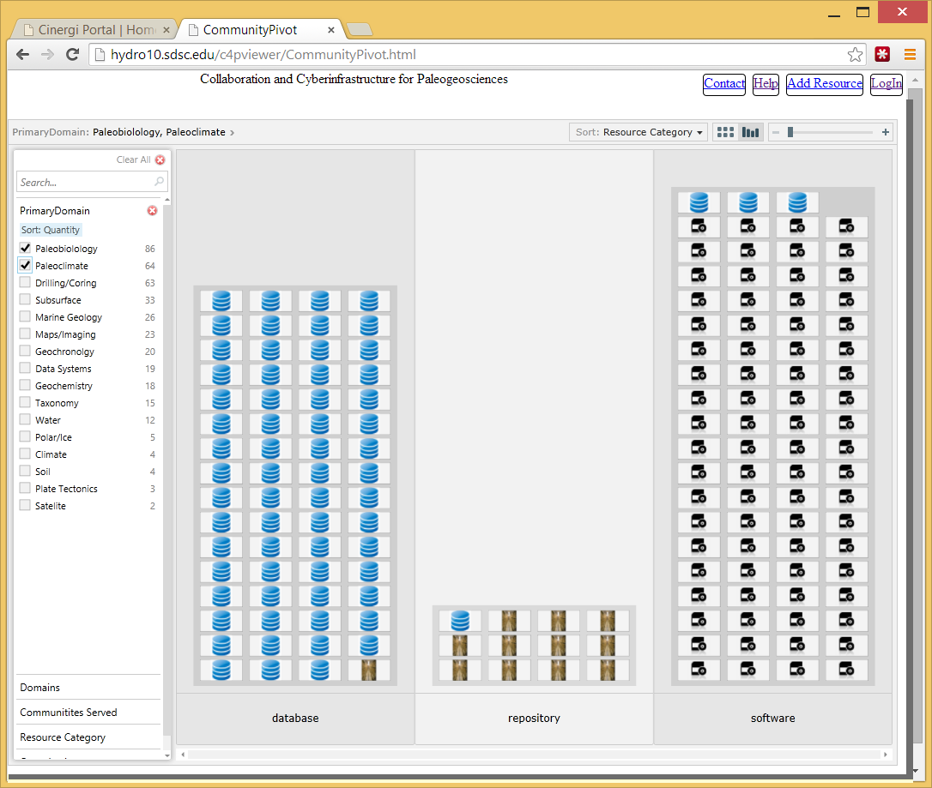
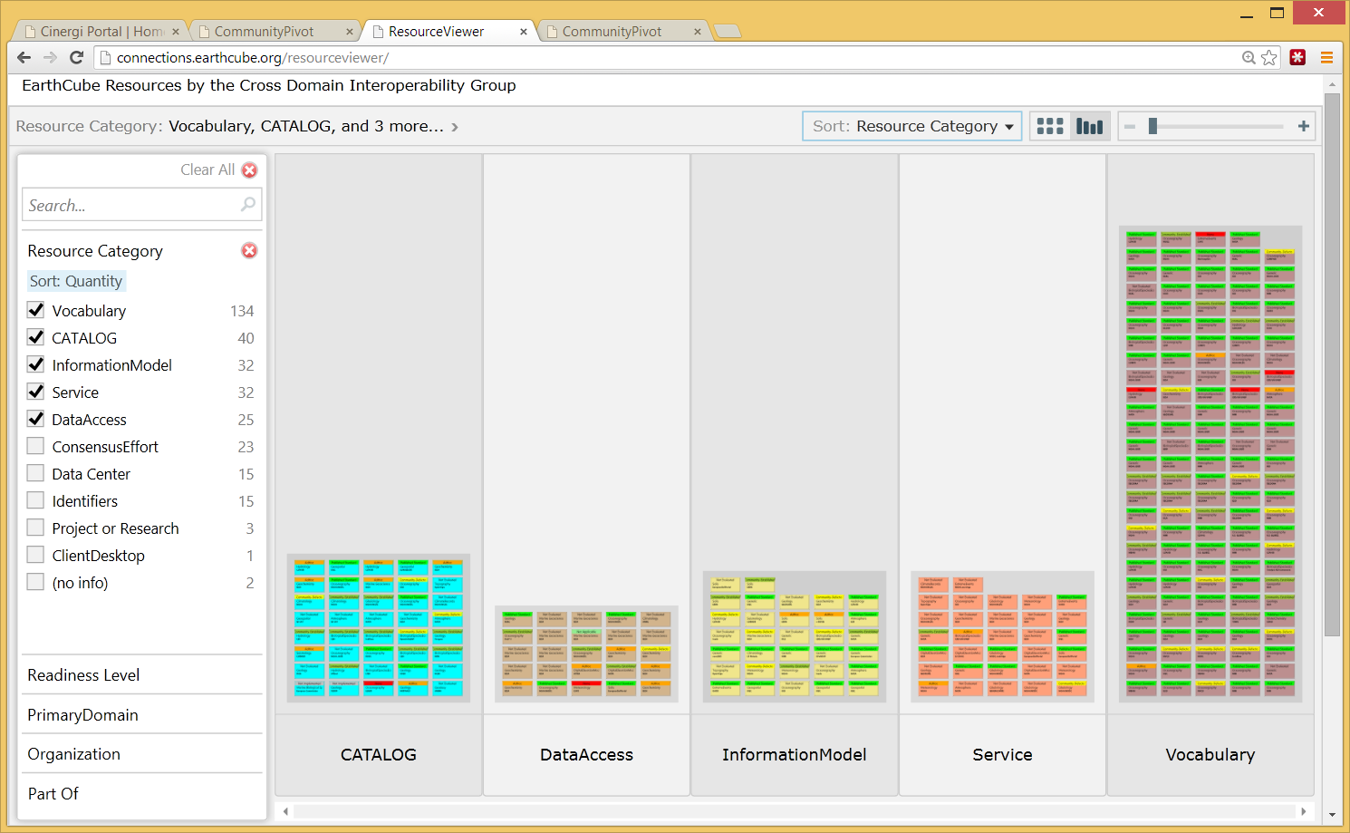
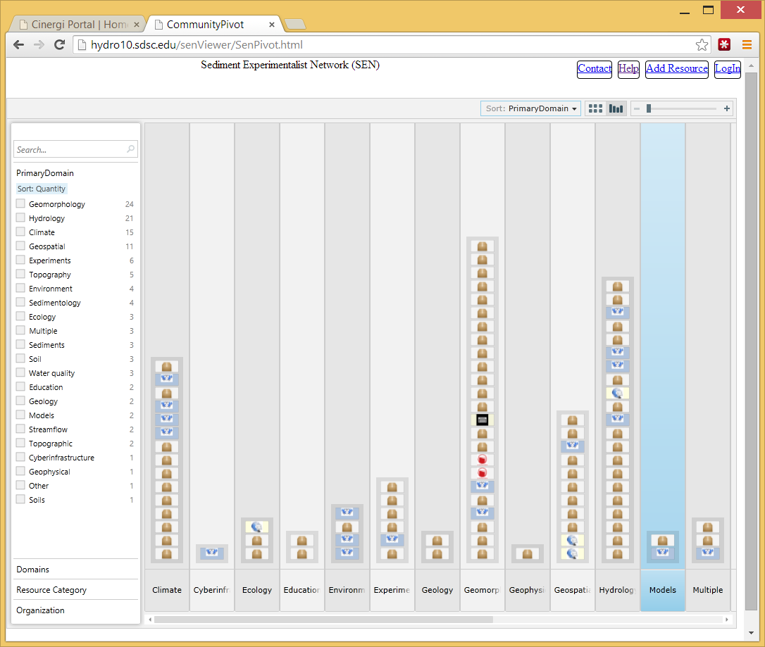
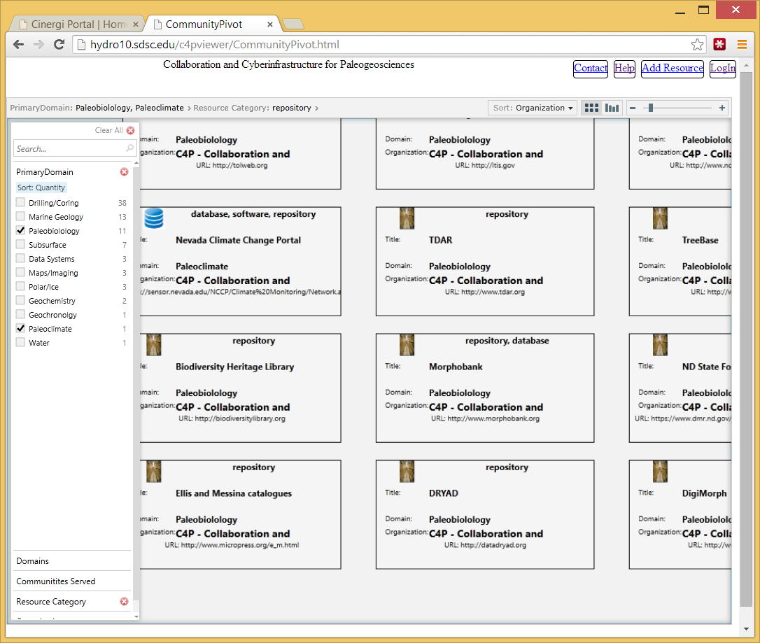
The CINERGI Metadata Pipeline CINERGI: Community Inventory of EarthCube Resources for Geoscience Interoperability
Domain Inventories
Domain workshops
Content enhancement
High-level assets
RCN (Research Coordination Networks)
http://cinergi.sdsc.edu/

Slide 7
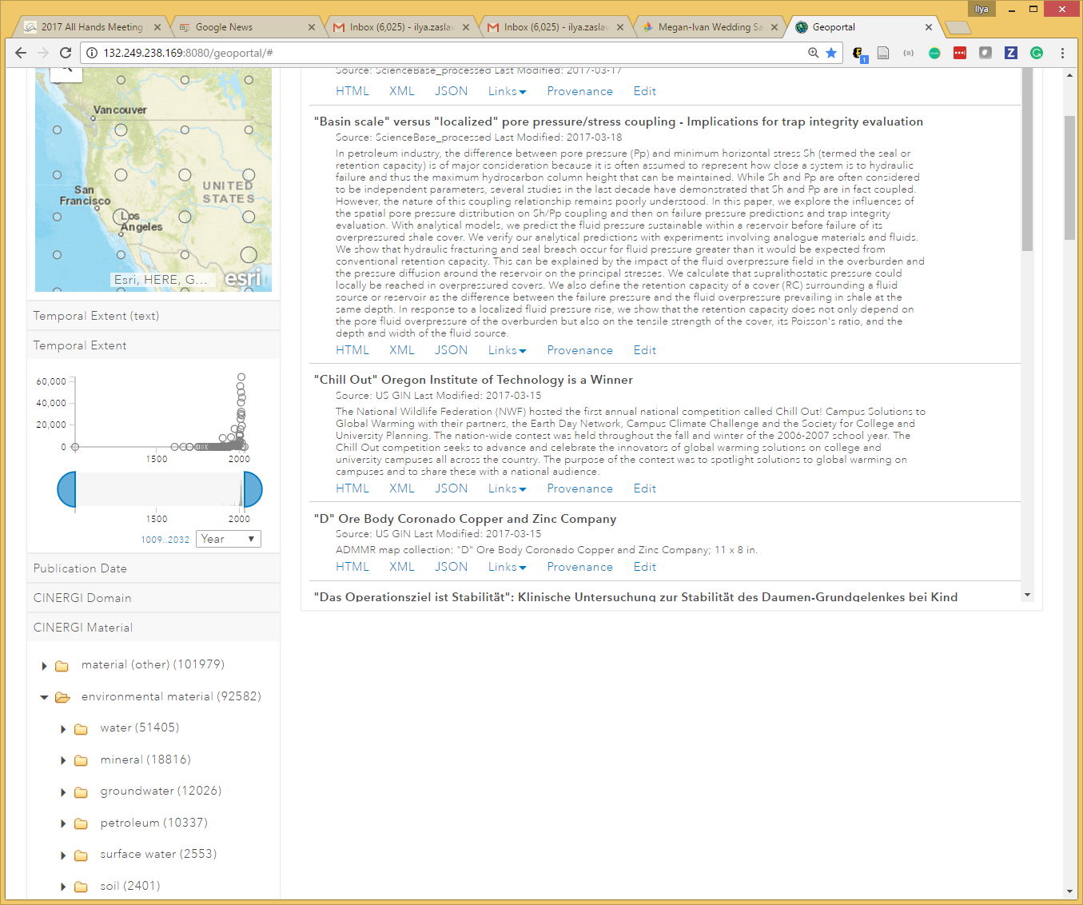
Content Enhancement Components
Common enhancer API
Provenance recording: W3C PROV and Neo4J
Spatial enhancer (bounding boxes)
Keyword enhancer
Materials; Processes; Equipment; Methods; Features; Activities; Science Domains; Geologic age; Organizations; Resource types
Organization Enhancer
Associate with Virtual Authority Identifiers
Collection Enhancer
Add keywords to a metadata collection
Temporal enhancer

Slide 8
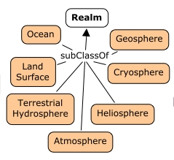
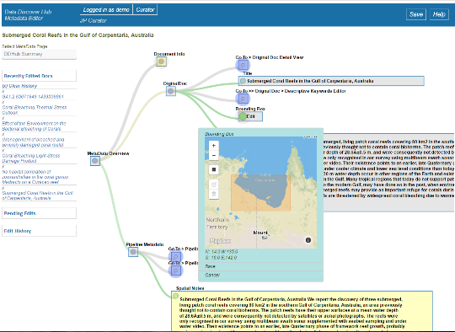

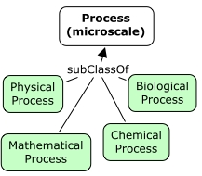

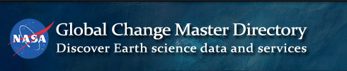
GeoSciGraph and Ontologies
GeoSciGraph ontology management system provides semantic infrastructure.
It relies on a cross-domain ontology of geoscience terms, amalgamating several independently developed ontologies or taxonomies
Some included ontologies:
SWEET
ENVO
CHEBI
YAGO (geo features)
NASA GCMD (equipment, providers)
GeoSciML
Geochronology
EDAM Bioinformatics (software terms and operations)
Also: VIAF
Added annotation properties for combining ontology fragments
(cinergiFacet, cinergiParent)
Metadata editor
Approve or discard
semantic annotations

Slide 9
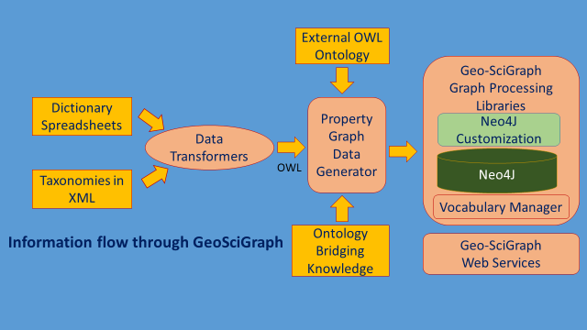
GeoSciGraph Services API
GeoSciGraph Services: The GeoSciGraph API exposes a set of web services for querying and exploring the CINERGI ontology.
Lexical Services are used to break text into sentences and perform sentence parsing using lightweight NLP techniques.
Vocabulary Services are used to find concepts, synonyms, term categories, autocomplete search, and term suggestions based on similarity.

Slide 10
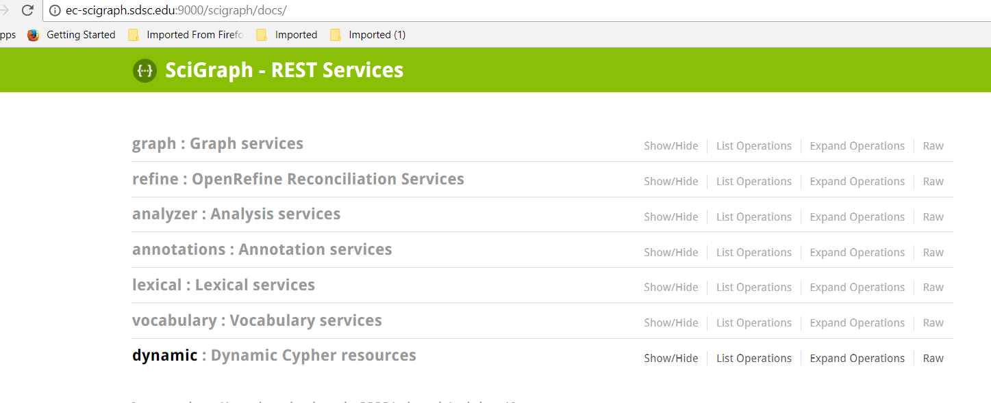
GeoSciGraph Services API
Graph Services are used to navigate the graph by following user-specified relationships and finding neighborhoods. Another service locates the head of a clique (all pair connected subgraph) in an ontology graph.
Refine Services provides a gateway to OpenRefine, Google service to match entries in a data table to an ontology.
Cypher Utility Service is a pass-through service that directs a user-specified Cypher query directly to the underlying Neo4J system.
Analyze Services provides a way to add custom-defined analyses into the GeoSciGraph system

Slide 11

Over 1 million records
From multiple repositories and EC contributions
Metadata automatically enhanced through CINERGI
Provenance tracing
Metadata editing
Automated semantic processing and indexing
Faceted search
Integration with EC Workbench

Slide 12
Metadata Sources in DDH
USGS
NOAA/NCEI
CUAHSI
Data.gov
USGIN
NGDS
CZO
NCDC
CORIS
DataCite
Re3data/databib
EarthCube projects
RCNs: C4P, SEN, ECOGEO, CRESCYNT
Model catalogs (NOAA, EPA, TESS)
Geoscience Australia
OpenTopography
IEDA (MGDS, ECL, MetPetDB)
EarthRef MagIC
CINERGI Cyberinfrastructure resources
DDH use cases

Slide 13
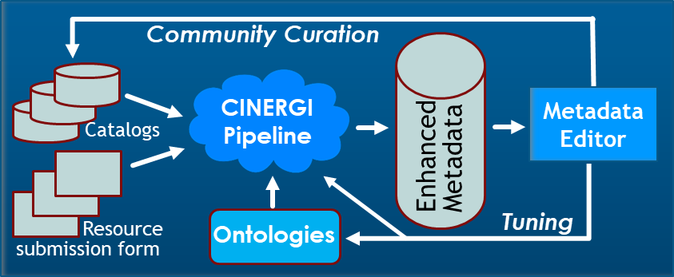
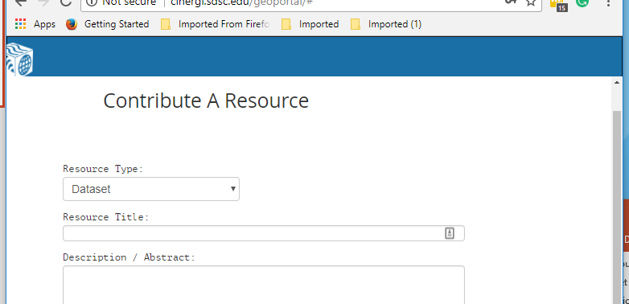
New Curation Model

Slide 14
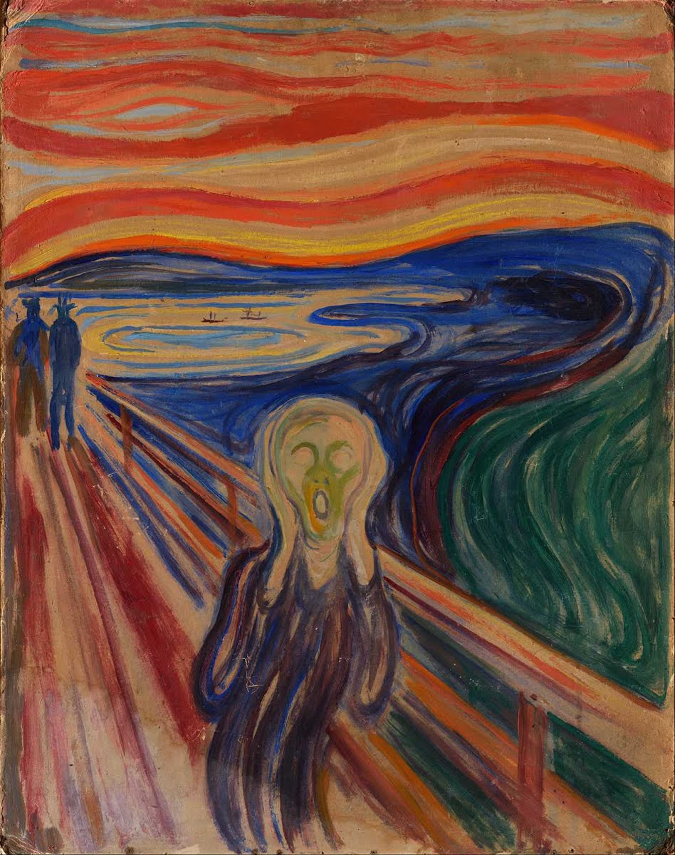
Interesting issues…
Semantic assignment
Selecting which ontology IDs to use when conflicts (machine learning)
Our ability to detect concepts and assign keywords may not match ontology’s level of detail
Scalable ontology alignment
Enabling faceting and search
Pre-defining upper facets; adjusting underlying ontology fragments for consistency; customizing for specific communities (eg promoting domain-specific search facets)
Generating corpus of text to analyze
Cross-granularity search
Criteria of success (Quality of search? Interoperability? Engaging domain users)

Slide 15
DDH is based on CINERGI technology for:
Metadata enhancement, using an extendable metadata augmentation platform
Semantic annotation, leveraging text analytics and a large composite ontology
Distributed metadata curation
Faceted search
DDH focus:
Improved search over expanded inventory
Enhanced ontology: additional vocabularies and relationships (semantic proxy, spatial, temporal)
Deeper dataset and repository registration
Search across granularity levels
EarthCube workbench integration
Complex discovery use cases

Slide 16
Workshop in the afternoon
Four key operations:
Search (text, spatial, temporal), over generated facets
Creating and indexing a semantically-enhanced ISO document
Metadata editing
Adding your own enhancer
Exploring the ontology
Exploring service APIs
SciGraph
CINERGI/foundry

